Slide 1

INFOMAX COLLEGE
OF
TECHNOLOGY
AND MANAGEMENT

Slide 2
Design and Document a Database system for BingBing Legend Mobile Game
GROUP MEMBERS
NABIN CHHETRI - NPI000032
CLASS PRESENTATION
SANDESH SUBEDI ‘A’ - NPI000040
SANDESH GIRI - NPI000041
SURAJ PANDEY - NPI000051
CT042-3-1IDB
INTRODUCTION TO DATABASE
4th March, 2021

Slide 3
Advantages of DBMS
Minimized Data redundancy
Improved data sharing
Improved data security
Increased end-user productivity

Slide 4
Disadvantages of File based system
Data Redundancy and Instability
Low Security
Chances of error and time consuming

Slide 5
RELATION TO OUR CASE STUDY
Permits us to check the data by creating, controlling and revising.
Multiple authorized users to gain the same database in different ways.

Slide 6
ACKNOWLEDGEMENT
Mr. Bidur Devkota (Subject Teacher)
Mr. Shreedhar Acharya

Slide 7
BUSINESS RULES
Distinctive email address and username is required during registration.
At least one hero must be owned prior to any skin purchase.
Only 5 (no more or less) active-players are permitted in a team.
Heroes must be selected uniquely within a team during the battle.

Slide 8
Normalization
1NF (First Normal Form) Rules:
Each record needs to be unique.
Each table cell should contain a single value.
2NF (Second Normal Form) Rules:
Table should be in 1NF.
No Partial Dependency.
3NF (Third Normal Form) Rules:
Table should be in 2NF.
Should not have transitive functional dependencies.

Slide 9
Entities
Players
Account
Hero
Skin
Game-mode
Team
Personal statistic
Game

Slide 10
Player:
Player_ID
Player_name
Email
Username
Global_level
Diamonds collected
Online_status
Hero_lvl
skin_owned
Hero
Hero_ID
Hero name
Hero_Role
Hero_Speciality
Hero_price
Skin:
Skin_ID
Skin name
Skin price

Slide 11
Game_mode:
Game_mode ID
Game_mode type
Game:
Game ID
Game_date
Battle_duration
Game result
Arena
Team:
Team_id
Personal statistics:
Result history
Game won
Additional detail
Nationality
v

Slide 12
Types of attributes
Simple attributes
Composite attributes
Single valued attributes
Multi valued attributes
Derived attributes
Key attributes

Slide 13
RELATIONSHIP TABLE
Relationship | Description
Player M:M Hero | One player can buy many heroes, one hero can be bought by many players. There exists many to many relationships between player and hero.
Hero 1:M skin | One hero can have many skins but a skin is associated with only one hero.
Player 1:M Personal statistics | A player has more than one personal statistics of different games that he has played.
Team M:1 game_mode | Many teams can choose the same game_mode but only one game_mode can be selected by a team for a game.
Team 1:M player | Each team in a game consists of at least five players, five players can play in one team.
Team M:1 game | A game can be played by only two teams and two teams are compulsory to play a game.
Game 1:1 personal statistics | A game records only one personal statistics of a player.

Slide 14
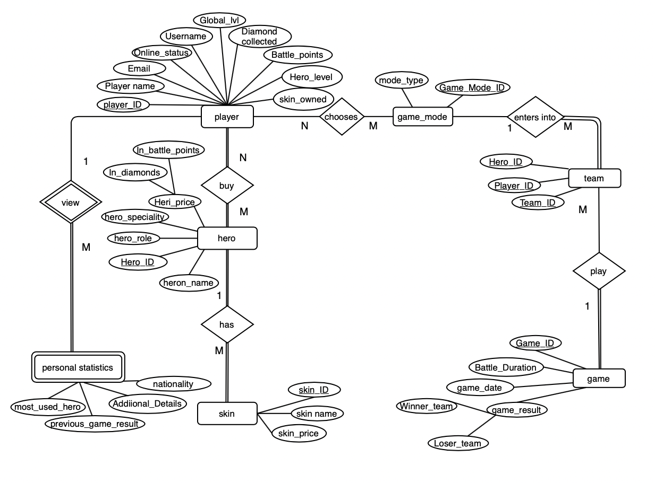
ERD(Entity Relationship Diagram)
Fig: ERD

Slide 15
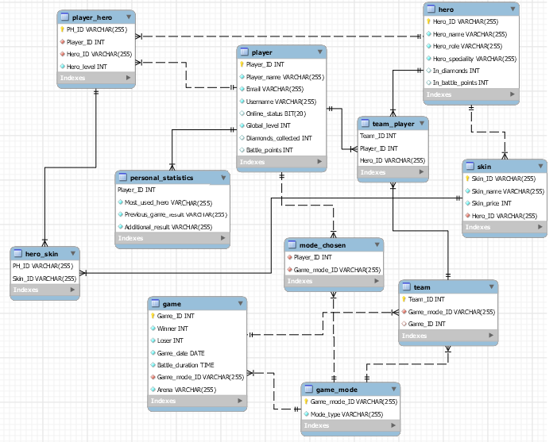
DATABASE DIAGRAM
Fig: Database Diagram

Slide 16
While converting Entity Relationship Diagram to relational schema we need to convert:
Each strong entity to relation and attributes to columns.
Multivalued attribute to separate table.
Relationships between entities declare foreign keys constraint for the table.

Slide 17
After conversion of ERD to relational schema the relations formed are:
Player {Player_ID, layer name, email, online_status, global_lvl, diamonds_collected, username, Hero_level, Skin_owned}
Hero {Hero_ID,Hero_name, hero_role, Hero_speciality, In_diamonds, In_battle_points}
Player_hero {PH_ID, player_ID*, Hero_ID*}
Skin {Skin_ID, Skin_name, skin_price, Hero_ID*}
Game_mode {Game_mode_ID, mode_type}
Team {Team_ID, Game_mode_ID*,Game_ID*}
Game{Game_ID, Game_mode_ID*,Arena,Battle_duration, Game_result, Game_date}
Team_player {Team_ID*, Player_ID*, Hero_ID*}
Mode_chosen {Player_ID*, Game_mode_ID*}
Personal_statistics {Player-ID*, Previous_game_result, most_used_hero, additional_details, nationality}

Slide 18
Table formed after normalisation up to 3NF
Relation: Player {Player_ID, Player_name, Username, Email, Online_status, Global_level, Diamonds_collected}
Relation: Hero {Hero_ID, Hero_name, Hero_role. Hero_speciality, In_diamonds, In_battle_points}
Relation: Skin{Skin_ID, Skin_name, Skin_price, Hero_ID*}
Relation: Player_hero {PH_ID, Player_ID*, Hero_ID*, Hero_level}
Relation: Hero_skin{PH_ID*, Skin_ID*}
Relation: Game_mode {Game_mode_ID, Mode_type,}
Relation: Team {Team_ID, Game_mode_ID*, Game_ID*}
Relation : Game{Game_ID, Battle_duration, Winner_team, Loser_team, Game_date. Arena, Game_mode_ID*}
Relation : Team_player {Team_ID*, Player_ID*, Hero_ID*}
Relation : Mode_chosen {Player_ID*, Game_mode_ID*,}
Relation : Personal_statistics {Player_ID, Most_used_hero, Previous_game_result, Additional_details}

Slide 19
END OF
PRESENTATION
THANK YOU !

